Slide 1
Amazon Product recommendation system using customer reviews
Category – Grocery Group Members :
Simran Mhaske – A20552202 Hrishikesh Pawar-A20543095 Harshal Sawant - A20538827
Ishan Prabhune - A20538828
Yashraj Diwate – A20553800
Pratik Patil – A20547062

Slide 2
Introduction
Our project focuses on analyzing Amazon customer reviews using a recommendation system. The motivation behind this project stems from the increasing reliance on online reviews for purchasing decisions. With the vast amount of reviews available on Amazon, it becomes challenging for users to sift through them to find relevant and trustworthy information.
We performed classification on sentiment_label column which was derived after sentiment analysis of text column. We used few columns which can be main factors which impact customer satisfaction at the most as a features to perform predict the sentiment label and perform classification.
We used content based filtering for building recommendation system.

Slide 3
Research Problem
In today's digital marketplace, we're tasked with creating a recommendation system to suggest similar products to users based on their reviews. Our focus is on delivering personalized recommendations while ensuring they meet a certain quality standard. Leveraging the vast Amazon Customer Reviews dataset, we'll preprocess the data and employ collaborative filtering techniques to predict products aligning with user preferences. Crucially, we'll filter out products with lower ratings to maintain recommendation quality and enhance user satisfaction. Our goal is to enrich the online shopping experience and foster long-term customer loyalty through tailored, high-quality recommendations.

Slide 4
Dataset
Dataset: Obtained from Stanford Network Analysis Project (SNAP), comprising around 13 million records.
Features include review ratings, titles, textual content, images, ASINs, user IDs, timestamps, and helpful votes.
Data Source : https://snap.stanford.edu/data/web-Amazon.html This is how our data looks:

Slide 5
Data Cleaning Flow
Handled Imbalance Issue
Review Dataset 13 Million Rows
(JSON -> CSV)
Getting 40K rows for each ratings(1:5)
Total rows of reviews – 200K
Total Dataset
110K Rows
Merged on parent_asin
Product Dataset 500K Rows (JSON > CSV)
Handled Null issues
Getting 198K for Product Data

Slide 6
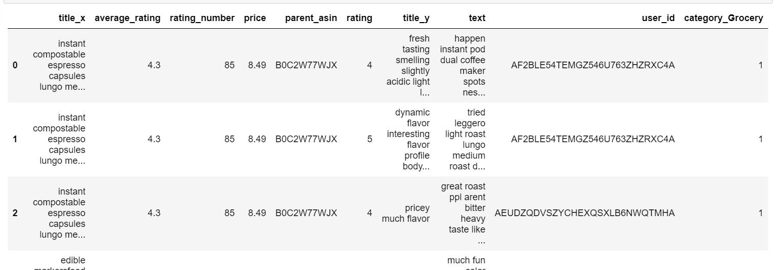
After Merging this is how our data looks like

Slide 7
Classification Model based on Product Review Sentiment
Loaded dataset of 110K rows
Performed Data Cleaning
Column named “Text” Pre-processing
Performed Sentiment Analysis
Computed Sentiment score(1,0) for each review
Created a ”Sentiment_Label” column
Considered few columns as features
Performed classification models
Evaluated models
Notes:
Performed Sentiment Analysis – using sentimentintensity analyer from NLTK Computed Sentiment score for each review – using polarity scores Considered few columns as features – columns – average rating, rating no., price, rating Evaluated models – SVM, Logistic regression, Gradient boosting, Random forest, XG boost, Ada boosting, decision tree, KNN, Multinomial Naïve bayes, Categorical Naïve Bayes

Slide 8
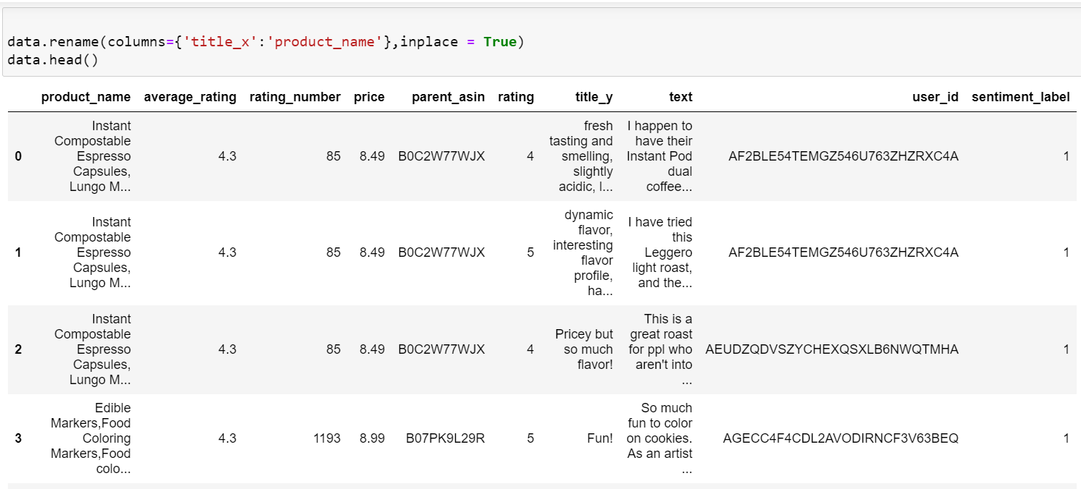
Overview of data and Data preprocessing
Dataset for Classification: You can see the ‘sentiment_label’ created in the dataset after data pre processing and sentiment analysis of the ‘text’ column.

Slide 9
Classification Model Results
Model | Accuracy | Recall |  | F1 |  | Precision
Sentiment_Label |  | 0 | 1 | 0 | 1 | 0 | 1
Decision Tree | 0.74 | 0.32 | 0.84 | 0.32 | 0.84 | 0.32 | 0.84
Knearest Neighbour (KNN) | 0.78 | 0.16 | 0.93 | 0.22 | 0.88 | 0.36 | 0.82
Random Forest | 0.77 | 0.22 | 0.91 | 0.27 | 0.87 | 0.36 | 0.83
Logistic Regression | 0.81 | 0 | 1 | 0 | 0.89 | 0 | 0.81
SVM | 0.808 | 0 | 1 | 0 | 0.89 | 0 | 0.81
GradientBoosting | 0.809 | 0 | 1 | 0 | 0.89 | 0.62 | 0.81
Ada Boost | 0.808 | 0 | 1 | 0.01 | 0.89 | 0.55 | 0.81
XG Boost | 0.804 | 0.06 | 0.98 | 0.1 | 0.89 | 0.41 | 0.81
Multinomial Naive Bayes | 0.71 | 0.18 | 0.85 | 0.19 | 0.83 | 0.21 | 0.81
Categorical Naive Bayes | 0.79 | 0.18 | 0.94 | 0.24 | 0.88 | 0.4 | 0.83

Slide 10
Content Based Recommendation Model Flow
Loaded dataset of 110K rows
Removed Stop words, applied Tokenization on reviews
TF-IDF Vectorization
Sparse Matrix for unigram, bigram and trigram.
Applied Padding on vectors
Normalization on vectors
Truncated SVD
Cosine similarity
NDGC

Slide 11
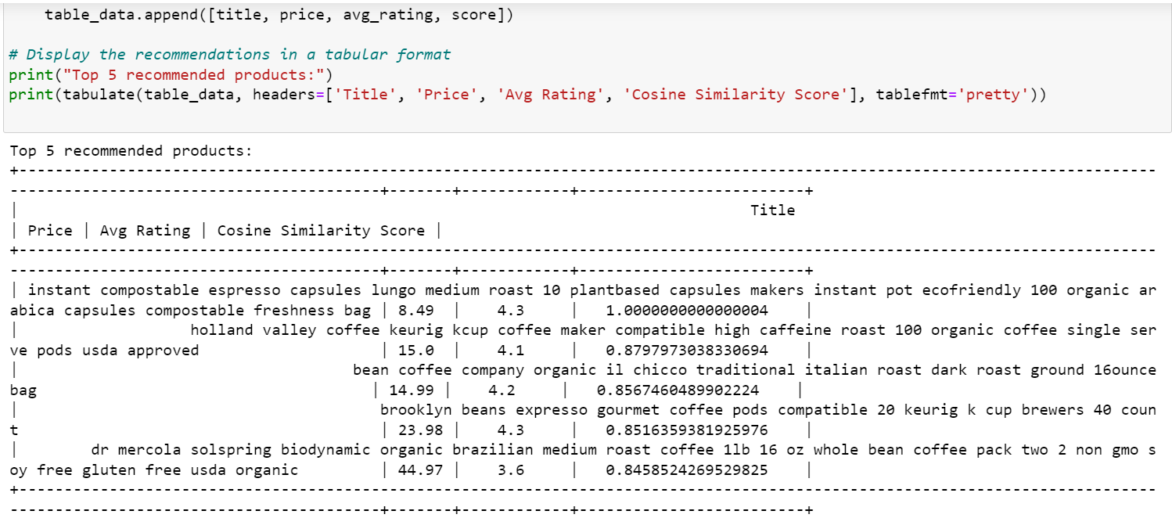
Recommendation Of Product

Slide 12
Recommendation Model Evaluation
Model | NDGC Score
Cosine Similarity – Unigram | 0.98
Cosine Similarity – Bigram | 0.99
Cosine Similarity – Trigram | 0.97
Cosine Similarity – Genism | 0.98

Slide 13
LOGICAL EXPLAINATION - 1
what item id have you taken :
we are using title_x as my item id to pass into the model to get recommendation. This is because the title_x which is product title contains string with brief information and keywords such as 'instant', 'good' etc. and hence comparing these with the reviews of the products would give best recommendations on them.
Comparing the similarities of the product with index product_index (referred to by its title in title_x) with all other products based on their reviews.
we created a get_recommendation function which iterates over chunks of the TF-IDF matrix to compute cosine similarity scores between the TF-IDF vector of the specified product (product_index) which would retrieve title of the product and the TF-IDF vectors of all other products.
The function returns a list of tuples containing the indices of recommended products along with their cosine similarity scores relative to the specified product.
This was our understanding from various online sources based on which we build the recommendation model.

Slide 14
LOGICAL EXPLAINATION - 2
how are you trying to recommend based on product title and review text –
During classification we have different columns to create a label column. But as our problem statement says, we are going to recommend the products based on the reviews posted by customer on provided product name.
So for this reason, we created sentiment_label column as our label variable based on sentiment analysis from the review’s text which is in ‘Text’ column.
All other columns such as average_rating, rating_number, rating and price are used as features to predict this sentiment_label column in our different classifications model.
On which later on, we have evaluated the different models using different evaluation metrics.

Slide 15
LOGICAL EXPLAINATION - 3
NDCG score explanation -NDCG is a ranking metric that evaluates the quality of the ranked list of recommendations.
It considers both the relevance of recommended items and their position in the list.Cosine similarity measures the similarity between items based on their feature vectors (e.g., TF-IDF vectors of reviews).
NDCG can be used to evaluate the quality of recommendations generated using cosine similarity if the relevance of recommended items can be assessed in a graded manner.

Slide 16
Thank You !

